Slide 1
Micro Credit Loan Use Case
Submitted by:- Parv Sharda

Slide 2
Introduction
Problem Statement:-
A Microfinance Institution (MFI) is an organization that offers financial services to low income populations. MFS becomes very useful when targeting especially the unbanked poor families living in remote areas with not much sources of income. The Microfinance services (MFS) provided by MFI are Group Loans, Agricultural Loans, Individual Business Loans and so on. Though, the MFI industry is primarily focusing on low income families and are very useful in such areas, the implementation of MFS has been uneven with both significant challenges and successes.
Today, microfinance is widely accepted as a poverty-reduction tool, representing $70 billion in outstanding loans and a global outreach of 200 million clients.
We are working with one such client that is in Telecom Industry. They are a fixed wireless telecommunications network provider. They have launched various products and have developed its business and organization based on the budget operator model, offering better products at Lower Prices to all value conscious customers through a strategy of disruptive innovation that focuses on the subscriber.
They are collaborating with an MFI to provide micro-credit on mobile balances to be paid back in 5 days. The Consumer is believed to be defaulter if he deviates from the path of paying back the loaned amount within the time duration of 5 days. For the loan amount of 5 (in Indonesian Rupiah), payback amount should be 6 (in Indonesian Rupiah), while, for the loan amount of 10 (in Indonesian Rupiah), the payback amount should be 12 (in Indonesian Rupiah).
We have to build a model which can be used to predict in terms of a probability for each loan transaction, whether the customer will be paying back the loaned amount within 5 days of insurance of loan. In this case, Label ‘1’ indicates that the loan has been payed i.e. Non- defaulter, while, Label ‘0’ indicates that the loan has not been payed i.e. defaulter.

Slide 3
Dataset
During the EDA process, we found that provided Dataset is having 37 features into it and 65,535 rows.
Mentioning the features names and it’s description below for a better understanding.
Label : Flag indicating whether the user paid back the credit amount within 5 days of issuing the loan{1:success, 0:failure}
Msisdn : mobile number of user
Aon: age on cellular network in days
daily_decr30: Daily amount spent from main account, averaged over last 30 days (in Indonesian Rupiah)
daily_decr90: Daily amount spent from main account, averaged over last 90 days (in Indonesian Rupiah)
Rental30: Average main account balance over last 30 days

Slide 4
Features with description
7. Rental90: Average main account balance over last 90 days
8. last_rech_date_ma :Number of days till last recharge of main account
9. last_rech_date_da : Number of days till last recharge of data account
10. last_rech_amt_ma : Amount of last recharge of main account (in Indonesian Rupiah)
11. cnt_ma_rech30 : Number of times main account got recharged in last 30 days
12. fr_ma_rech30 : Frequency of main account recharged in last 30 days
13. sumamnt_ma_rech30: Total amount of recharge in main account over last 30 days (in Indonesian Rupiah)
14. medianamnt_ma_rech30: Median of amount of recharges done in main account over last 30 days at user level (in Indonesian Rupiah)
15. medianmarechprebal30 : Median of main account balance just before recharge in last 30 days at user level (in Indonesian Rupiah)
16. cnt_ma_rech90: Number of times main account got recharged in last 90 days
17. fr_ma_rech90: Frequency of main account recharged in last 90 days

Slide 5
Features with description
18. sumamnt_ma_rech90: Total amount of recharge in main account over last 90 days (in Indonasian Rupiah)
19. medianamnt_ma_rech90: Median of amount of recharges done in main account over last 90 days at user level (in Indonasian Rupiah)
20. medianmarechprebal90: Median of main account balance just before recharge in last 90 days at user level (in Indonasian Rupiah)
21. cnt_da_rech30 : Number of times data account got recharged in last 30 days
22. fr_da_rech30: Frequency of data account recharged in last 30 days
23. cnt_da_rech90: Number of times data account got recharged in last 90 days
24. fr_da_rech90: Frequency of data account recharged in last 90 days
25. cnt_loans30: Number of loans taken by user in last 30 days
26. amnt_loans30: Total amount of loans taken by user in last 30 days
27. maxamnt_loans30: maximum amount of loan taken by the user in last 30 days
28. medianamnt_loans30: Median of amounts of loan taken by the user in last 30 days
29. cnt_loans90: Number of loans taken by user in last 90 days

Slide 6
Features with description
30. amnt_loans90: Total amount of loans taken by user in last 90 days
31. maxamnt_loans90: maximum amount of loan taken by the user in last 90 days
32. medianamnt_loans90 : Median of amounts of loan taken by the user in last 90 days
33. payback30: Average payback time in days over last 30 days
34. payback90: Average payback time in days over last 90 days
35. pcircle: telecom circle
36. pdate: date
Target:- Feature ‘Label’ is our target column where 0 denotes: not paid and 1 denotes paid.
From data.info() function we got to know that we have 2 object, 1 datatime64, 14 integer and rest 20 float type features.

Slide 7
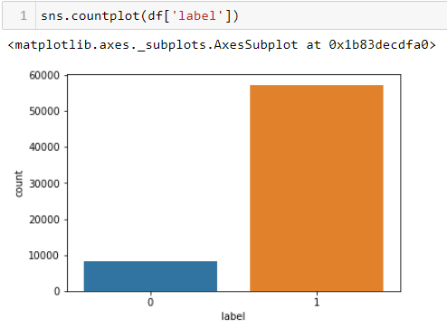
EDA
During the EDA and visualization part we noticed that almost in our Target column 80 % of the values are 1 which denotes that almost 80% of the applicants are returning the loans within 5 days time period.

Slide 8
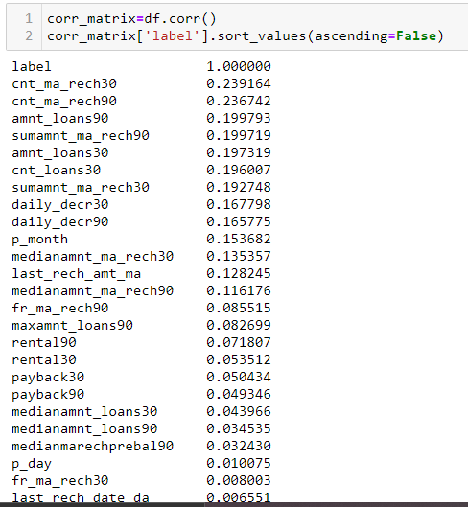
Correlation of our target column with features
By checking the correlation matrix and .corr() function we found that the correlation of our target column with the features in Descending order.

Slide 9
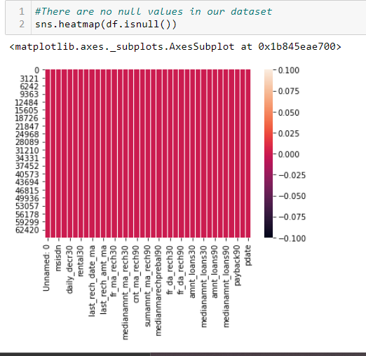
Correlation of our target column with features
By looking at our output we understand that out target is most correlated with cnt_ma_rech30, cnt_ma_rech90 and so on.
Where as on the other end features like fr_da_rech90, medianmarechprebal30 and so on are most negatively correlated with our target feature
By using .isnull().sum() function and heatmap we got to know that we don’t have any null values in our dataset.

Slide 10


Data Preprocessing part
In the data pre-processing part our first task was to handle the features which were not in float or integer data time as numeric values are mandatory for model building.
From data.info() function we got to know that we have 2 object, 1 datatime64, 14 integer and rest 20 float type features.
By checking unique values in Pcircle feature, we got to know that this feature only contains 1 unique value i.e. “UPW”, instead of converting it into a numeric column using Label Encoding I found dropping this column a good idea.

Slide 11
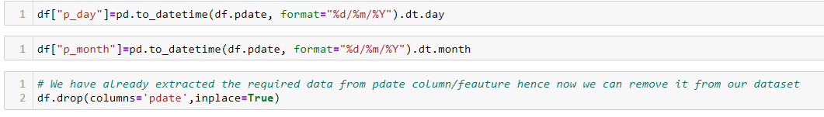
Data Preprocessing part
Then we had feature ‘pdate’ in DateTime datatype. Checked unique values using data.unique() function where I found that this data is for the year 2016. using .dt.day/dt.month function I successfully extracted the Date and Month from this and as the data is from the same year 2016 I didn’t extracted that. After extracting the required values I dropped ‘pdate’ column as well.

Slide 12

Data Preprocessing part
Our last non numeric column was ‘msisdn’ which was in Object datatype. After checking the unique values in this column we found that all the unique values were numeric however in the middle of the number there was I sign. It was not sure what I denotes and hence instead of removing or replacing it with some other number was not a good idea. Hence we dropped this column as well.
From above information, we can understand that we dropped all 3 non numeric columns.

Slide 13
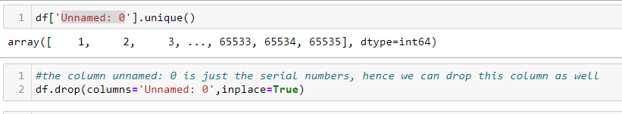
Data Preprocessing part
We had one more feature under the name of “Unnamed: 0’, after checking unique values in this feature I found that this was just the indexing of each row. Hence dropped this feature as well.
Now all our dataset is in numeric form, which was the requirement for our model building.
We are left with two major steps now:
Outlier check and removal, if any
Skewness check and removal, if any

Slide 14
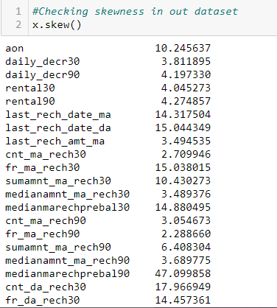
Data Preprocessing part
There is huge skewness in the dateset.
I tried to remove the skewness using different methods such as np.log, np.sqrt, power transform, cuberoot transformation and min max scaler however no satisfactory output, hence I decided to continue with this.

Slide 15
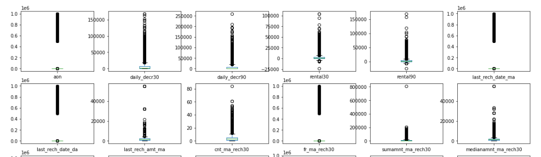
Data Preprocessing part
By using boxplot method, we understand that there are extreme outliers in our dataset.

Slide 16
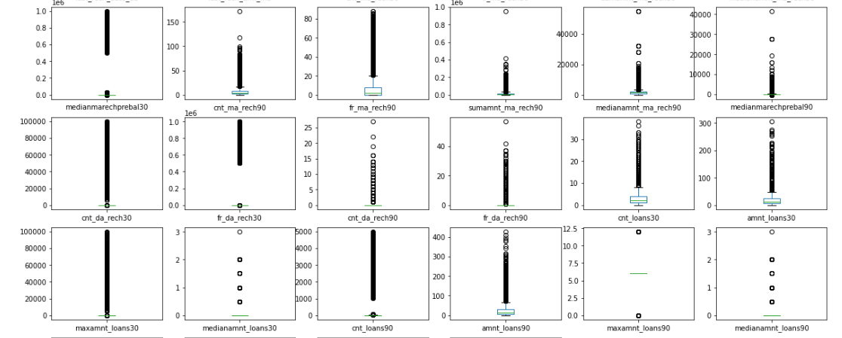
Data Preprocessing part

Slide 17
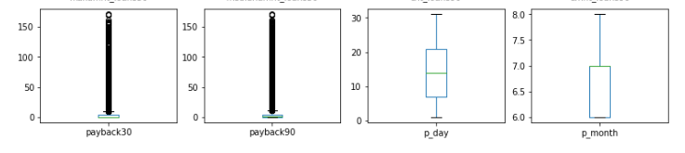

Data Preprocessing part
By using z-score methods to trim/remove outliers we were losing 23% data, which was not good for our model.
Tried IQR method as well however no satisfactory response, hence I decided to leave them as it is.
Splitting our dataset in x and y:-

Slide 18
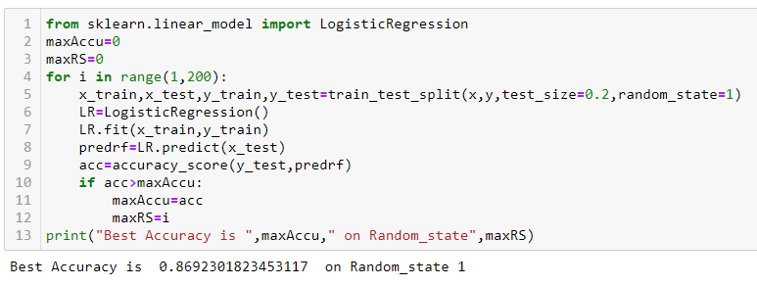
Model Building
Selecting our best Random state
We above output we understand that the best random state is 1, hence we will be using the same random state in further processes.

Slide 19
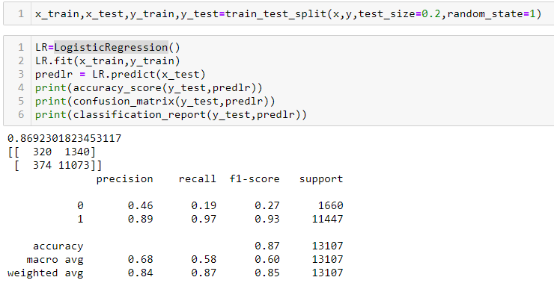
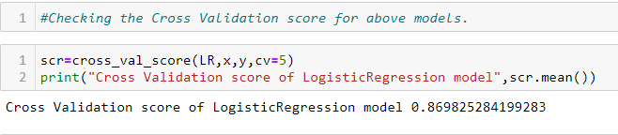
Model Building
We used four different methods for our model building to check which one works the best.
Logistic Regression

Slide 20
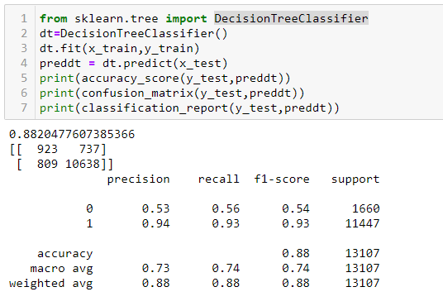

Model Building
2. Decision Tree Classifier

Slide 21
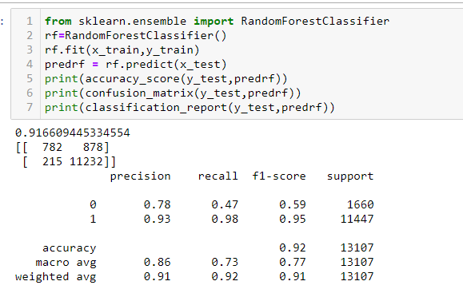

Model Building
3. Random Forest Classifier

Slide 22
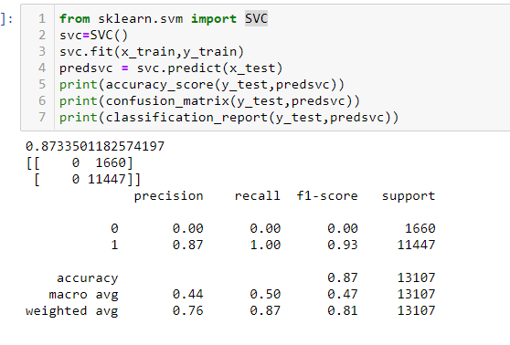

Model Building
4. SVC

Slide 23
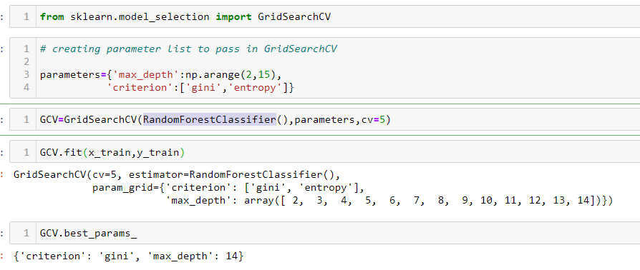
Model Building
From the above results we understand that the best model is Random Forest Classifier, now we will perform hyper parameter tuning using GridSearchCV to improve the model performance.

Slide 24
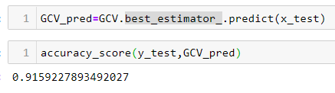

Model Building
Saving our best model using pickle

